Slide 1
SQL Lesson 15a
Set Operators
V1.0 2020

Slide 2
Lesson Objectives
After completing this lesson you will be able to
Describe how Set Operators work
Use different Set Operators to combine output columns of data from multiple queries
Control the order of rows returned by set operators

Slide 3
Set operators
Introduction to set operators
Union all and union
Intersect
Minus
Set operator guidelines
Matching the select statements

Slide 4
Introduction to set operators
 |  | UNION / UNION ALL – Standard SQL
 |  | INTERSECT
 |  | MINUS

Slide 5
Introduction to set operators
Set Operators combine the results of two or more queries into one result.
Operator | Returns
Union All | Returns all rows selected including duplications
Union | Returns all rows selected eliminating duplications
Intersect | Returns the rows that are common to both queries
Minus | Returns rows from the first query that are not selected by the next query

Slide 6
Set operators
Introduction to set operators
Union all and union
Intersect
Minus
Set operator guidelines
Matching the select statements

Slide 7
Union all
Returns the data from both queries including all duplications

Slide 8
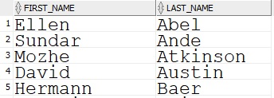
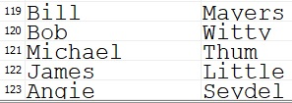
Union all
Displays all employees and consultants including duplicated rows
Result is not sorted
SELECT first_name, last_name
FROM employees
UNION ALL
SELECT first_name, last_name
FROM consultants;
…

Slide 9
Union
Returns the data from both queries excluding all duplications

Slide 10
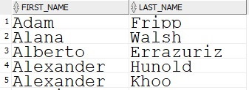
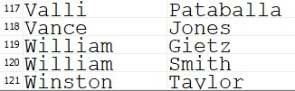
Union
Displays all employees and consultants removing duplicated rows
Performs a record sort, from left to right
SELECT first_name, last_name
FROM employees
UNION
SELECT first_name, last_name
FROM consultants;
…

Slide 11
Set operators
Introduction to set operators
Union all and union
Intersect
Minus
Set operator guidelines
Matching the select statements

Slide 12
Intersect
Returns the rows that are common to both queries
Common Data

Slide 13

Intersect
Displays names that appear in both tables, removing duplicated rows
Performs a record sort
SELECT first_name, last_name
FROM employees
INTERSECT
SELECT first_name, last_name
FROM consultants;

Slide 14
Set operators
Introduction to set operators
Union all and union
Intersect
Minus
Set operator guidelines
Matching the select statements

Slide 15
Minus
Returns the distinct rows selected by the first query not selected by the next query
Returns the data from here…
that is not found there

Slide 16
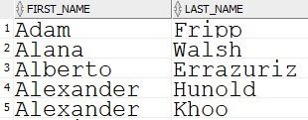
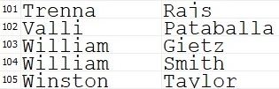
Minus
Displays employees who are not consultants, removing duplicated rows, if any
Performs a record sort
SELECT first_name, last_name
FROM employees
MINUS
SELECT first_name, last_name
FROM consultants;
…

Slide 17
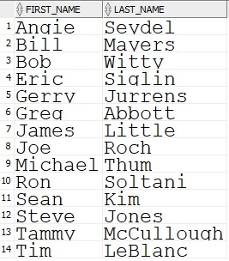
Minus
Displays consultants who are not employees
SELECT first_name, last_name
FROM consultants
MINUS
SELECT first_name, last_name
FROM employees;

Slide 18
Set operators
Introduction to set operators
Union all and union
Intersect
Minus
Set operator guidelines
Matching the select statements

Slide 19
Set operator Guidelines
All column headings come from the first query, so use generic column aliases as needed
The number of columns selected must match
The datatype family of the columns selected must match

Slide 20
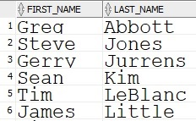
Set operator guidelines
The order by clause can appear only once, at the very end
To avoid confusion, it is common practice to order by column integers
SELECT first_name, last_name
FROM consultants
MINUS
SELECT first_name, last_name
FROM employees
ORDER BY 2;
…

Slide 21
Set operators
Introduction to set operators
Union all and union
Intersect
Minus
Set operator guidelines
Matching the select statements

Slide 22
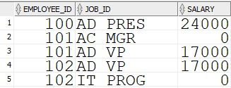
Matching the select statements
SELECT employee_id, job_id, salary
FROM employees
UNION
SELECT employee_id, job_id, 0
FROM job_history;
…

Slide 23
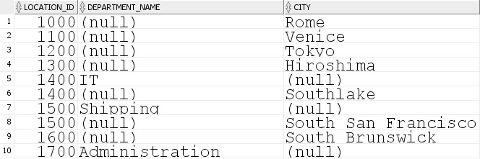
Matching the select statements
SELECT location_id, department_name, NULL AS city
FROM departments
UNION
SELECT location_id, NULL, city
FROM locations;
…

Slide 24
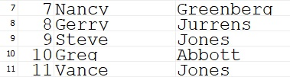
Quiz
Does the following UNION show duplicates?
SELECT consultant_id as id, first_name, last_name
FROM consultants
UNION
SELECT employee_id, first_name, last_name
FROM employees;
…
…
…

Slide 25
Quiz
True or false?
All set operators sort and remove duplicates
Intersect can show the same results as a join
Set operators are limited to two queries
Datatypes can be mixed in the same output column
The number of columns selected does not need to match from one query to the next

Slide 26
Review
In this lesson you learned how to
Describe how Set Operators work
Use different Set Operators to combine output columns of multiple queries
Control the order of rows returned by set operators

Slide 27
Questions?

